Slide 1

Personalized Asthma Alerting Prototype
by Joyojyoti Acharya (AI04834)
In Guidance of:
  Moova, Nageshwara Rao
  P, Sai Kishore Reddy
  Bandaru, Amarendra

Slide 2

Personalized Asthma Alert Prototype
What is Asthma?
Asthma is a long-term condition affecting children and adults. The air passages in the lungs become narrow due to inflammation and tightening of the muscles around the small airways. This causes asthma symptoms such as cough, wheeze, shortness of breath and chest tightness.
Key Facts:
  . Asthma is a major noncommunicable disease (NCD), affecting both children and adults, and is the most common chronic disease among children
  Inflammation and narrowing of the small airways in the lungs cause asthma symptoms, which can be any combination of cough, wheeze, shortness of breath and chest tightness.
  Asthma affected an estimated 262 million people in 2019 and caused 455 000 deaths worldwide.
  Inhaled medication can control asthma symptoms and allow people with asthma to lead a normal, active life.
  Avoiding asthma triggers can also help to reduce asthma symptoms.
Reference: World Health Organization (WHO)

Slide 3
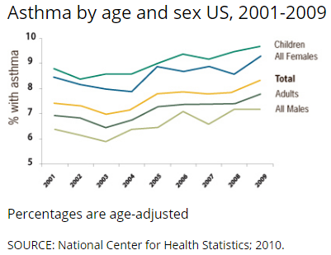
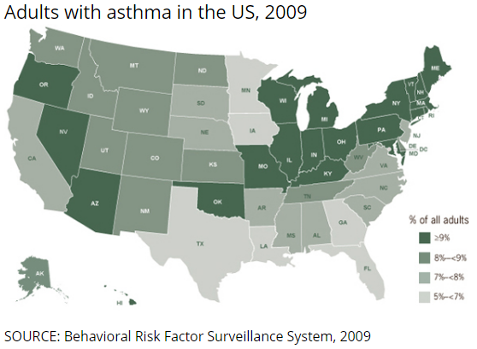

Personalized Asthma Alert Prototype
Why Asthma? U.S. Report:
Roughly 1 in 13 Americans have asthma, which is about 25 million people in the US Population.
About 20 million U.S. adults aged 18 and above have Asthma.
Around 9.8% of female adults have asthma, compared to 6.1% of male adults.
Around 5.1 million children under the age of 18 reported of having Asthma.
Asthma Attack Rates:
  In 2019, 44.3% of children under the age 18 had reported one of more Asthma Attacks.
  In 2019, 40.4% of adults aged 18 or above had reported one of more Asthma Attacks.
Asthma Death Counts:
  11 people in the U.S. die from asthma each day.
  In 2020, 4,145 people died from asthma and most of these deaths are avoidable with the right treatment and care.
  In 2020, deaths due to asthma rose for the first time in 20 years.
Reference: Asthma & Allergy Foundation of America

Slide 4
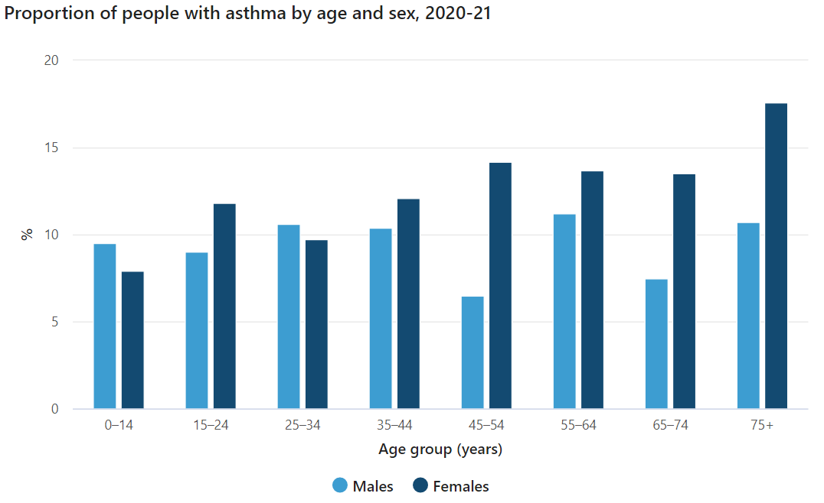
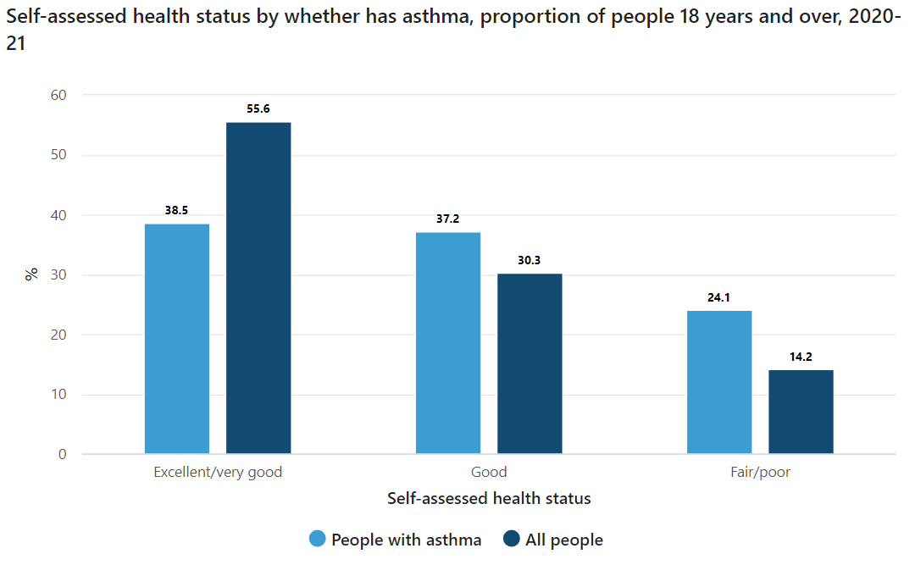


Personalized Asthma Alert Prototype
Why Asthma? Australian Report:
Roughly 2.7 million people had Asthma in 2020-21, which is around 10.7% of the total population in Australia.
Around 12.0% of female adults have asthma, compared to 9.4% of male adults.
Among children (aged 0-14) 9.5% of male and around 7.9% of female children reported Asthma.
In 2018, there were 389 deaths due to asthma in Australia (0.2% of all deaths), which corresponds to a mortality rate of 1.3 per 100,000 population.
Death from asthma is uncommon and effective management can reduce the risk even further.

Slide 5

Personalized Asthma Alert Prototype
  The counts are endless and increasing every year &
  with the certain rise of COVID pandemic,
  Asthma Counts are also forced to increase.
  Hence,
  ASTHMA is declared as one of the most COMMON RESPIRATORY DISEASES
  all over the world.
Reference: Centers for Disease Control and Prevention

Slide 6
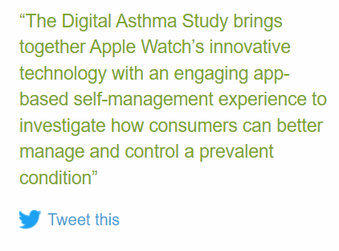
Personalized Asthma Alert Prototype
Our Goal and Anthem Study on Asthma:
Goal:
  Designing a personalized AI based prototype for users to detect if a certain weather is asthma prone or not.
  The prototype will alert the user about the Asthma Risk.
Motivation/Similar Work:
  Anthem announced Research Study with Apple Inc., University of California and CareEvolution to help improving Asthma Management, 2020.
Reference: Link1, Link2, Link3

Slide 7
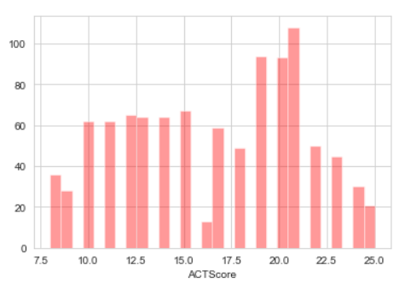
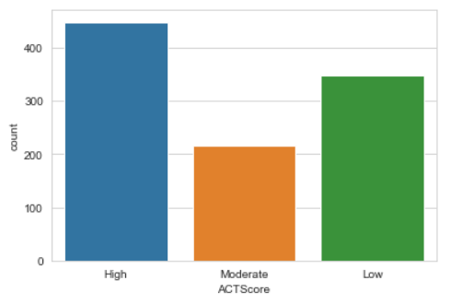


Personalized Asthma Alert Prototype
Proposed Methodology with Live Demo:
Insights of Asthma:
  Dependency of Environment Variables (Temperature, Humidity, UV Index, Windspeed, Pressure etc.).
  Connection with Personalized Features (Gender, Age etc.)
  Dependency of Individual Habits (Smoking, Outdoor Activities etc.)
Dataset & Target Variable:
  Dataset: Link
  Target Variable: ACTScore
    According to American Thoracic Society (ATS), Asthma Control Test Score (ACTScore) typically ranges from 5 (Poor Control of Asthma) to 25 (Complete Control of Asthma)
    Again, according to National Library of medicine, an ACT score ≥ 20 indicates controlled asthma (Low Risk), scores from 16 to 19 indicate partly controlled asthma (Moderate Risk), and scores < 16 indicate uncontrolled asthma (High Risk).

Slide 8
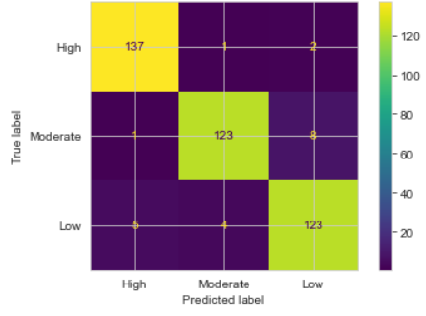
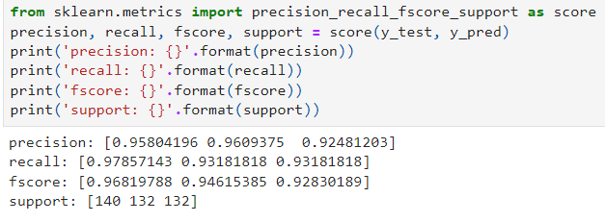


Personalized Asthma Alert Prototype
Proposed Methodology with Live Demo:
Model:
  We classified the Target variable.
  We handled the Data Class imbalance using SMOTE algorithms.
  Used different Machine Learning Algorithms.
  Random Forest provided the Evaluation Measures.
  Used StreamLit to design an UI for the Model to extract personalized data from user.
  We also used “OpenWeatherAPI” to extract relevant features from the Given Location.
  We added “Geocoder” to detect location from IP Address.
  Finally, We used Explainable AI to unfold the contribution of different features towards the end result.
  And the final output is also produced to the user via StreamLit UI.

Slide 9
Personalized Asthma Alert Prototype
Future Scope:
  With more data available the dependency of different features with Asthma can be detected.
  We can implement the whole prototype into smart wearables to alert the users.
  We can also implement the prototype into different mobile applications to alert the users about their current Asthma Conditions.

Slide 10
Personalized Asthma Alert Prototype
  Let’s Look at a Live Demo?

Slide 11
Personalized Asthma Alert Prototype
  Prevention is Better than Cure!
  Say NO to Asthma!

Slide 12
Personalized Asthma Alert Prototype
  Thank You.

